Slide 1

OLYMPICS DATASET ANALYSIS
Submitted by
Sharma Nikki

Slide 2
Introduction:
The modern Olympic Games or Olympics are leading international sporting events featuring summer and winter sports competitions in which thousands of athletes from around the world participate in a variety of competitions.
Dataset Usage
The data source used - Kaggle and the dataset consists of more than 200k records
Data is exported in csv format and is structured data
The data used is from 1890 -2017
Variables
Dependent Variable – Medal
Independent Variable - Sport, City, Games (season),Team(Country), Year, Age, Weight, Height , Gender

Slide 3

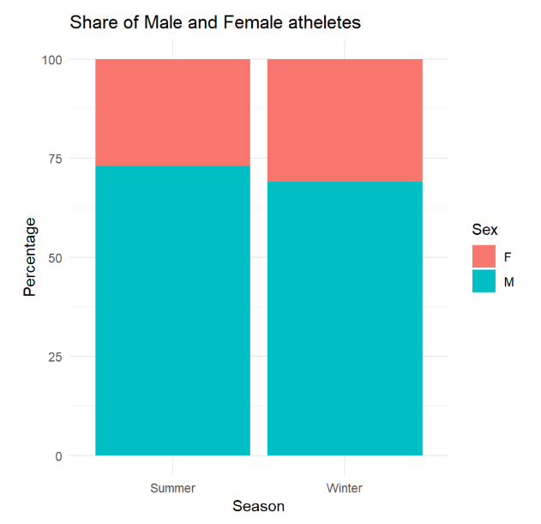
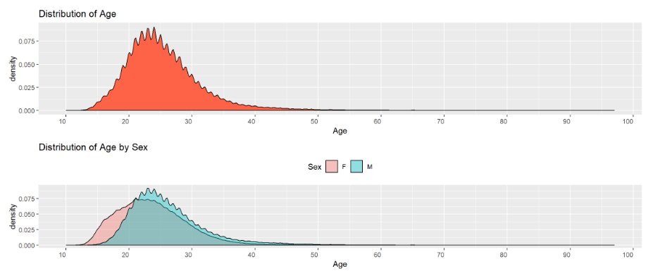
DISTRIBUTION BY AGE & SEX OF ATHLETES

Slide 4
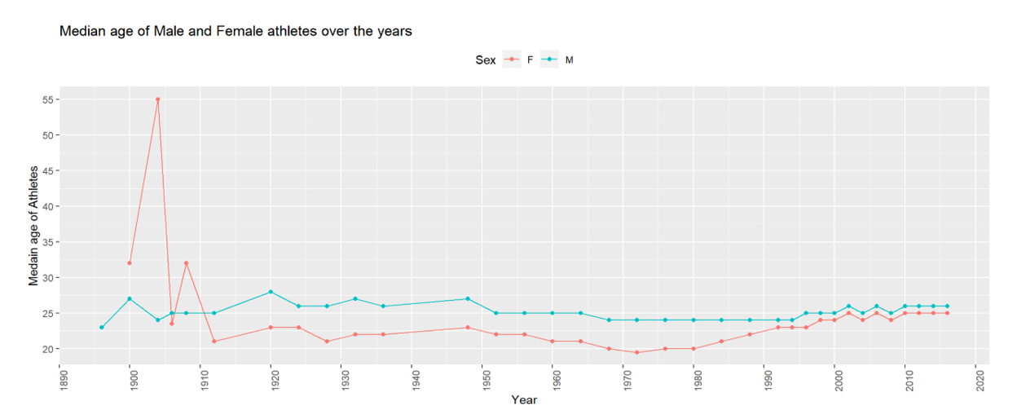
MEDIAN AGE OF ATHLETES OVER THE YEAR

Slide 5
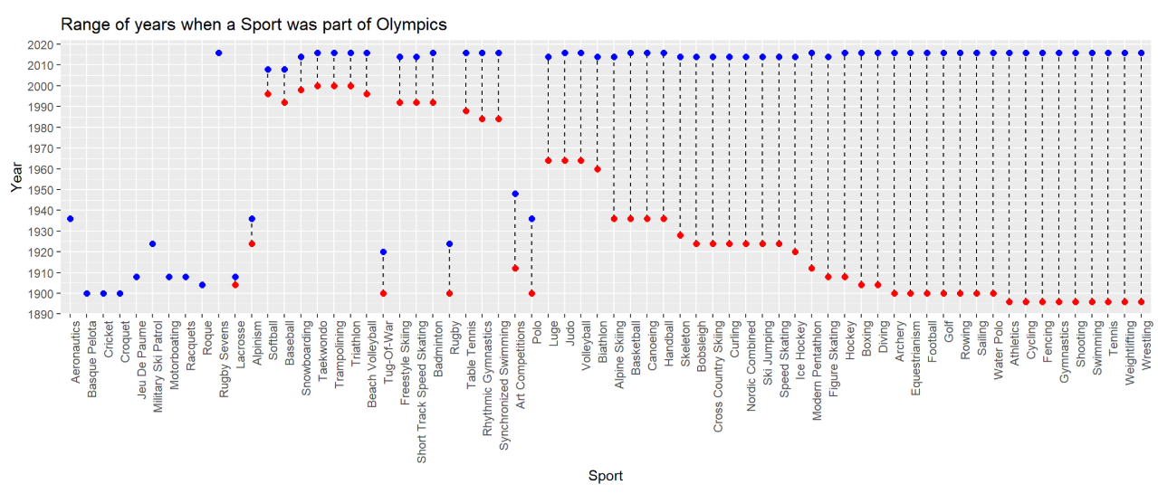
Sports -
Sports introduced
Sports part of Olympic
RANGE OF YEAR OF SPORTS BEING PART OF OLYMPICS

Slide 6
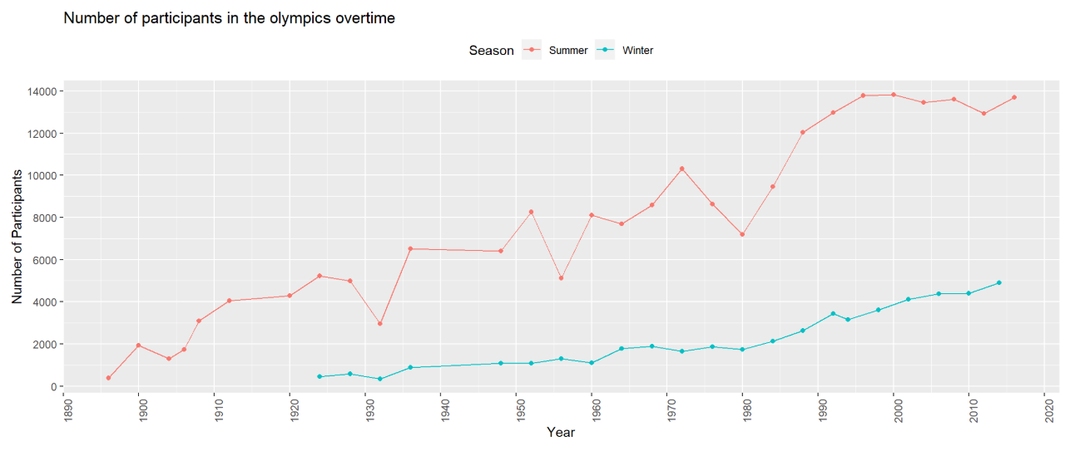
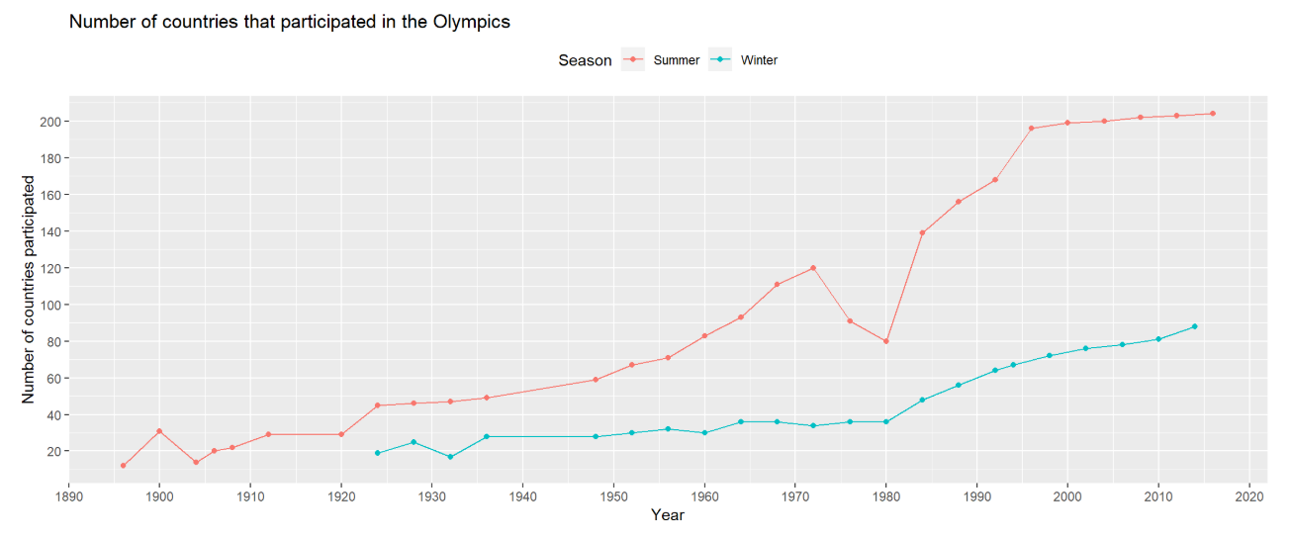
OLYMPIC PARTICIPATION COUNT

Slide 7
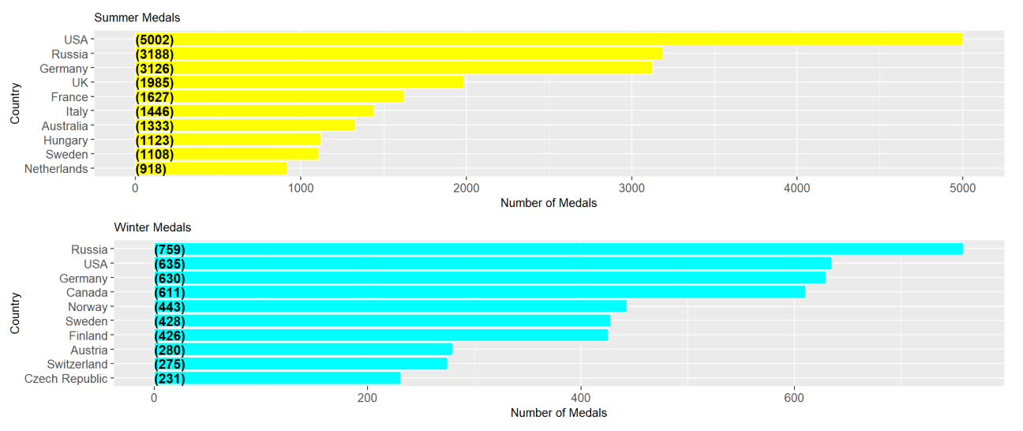
top 10 MEDAL winners in each SEASON

Slide 8
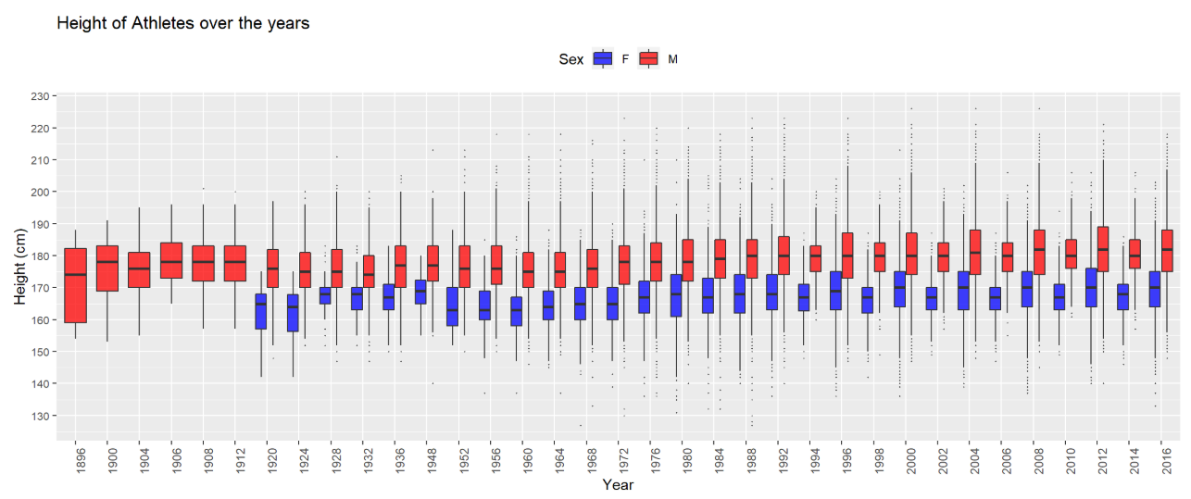
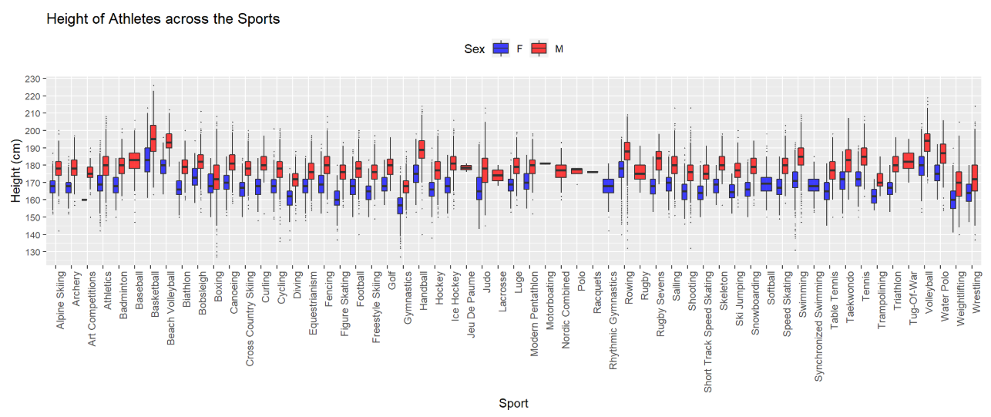
Athletes' HEIGHT distribution over the Years & across SPORTS

Slide 9
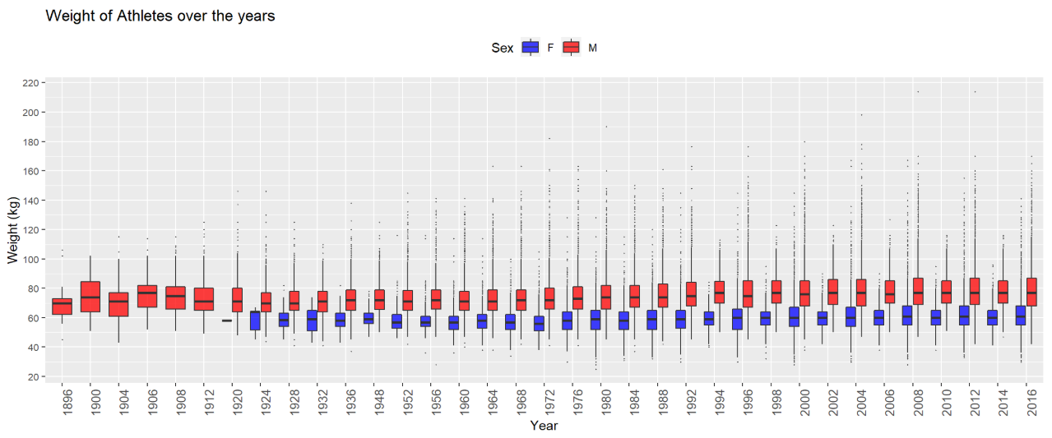
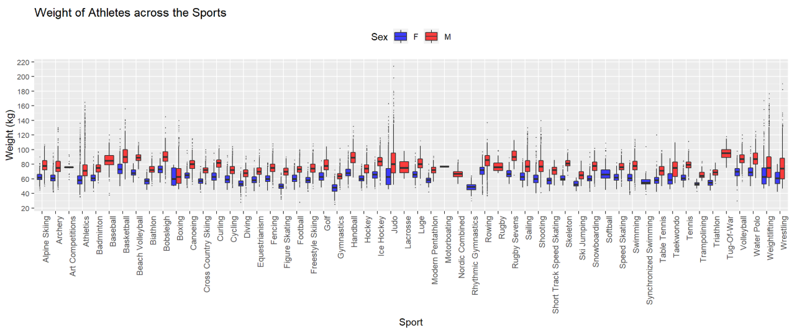
Athletes' weight distribution over the Years & across SPORTS

Slide 10
PROBABILITY OF WINNING

Slide 11
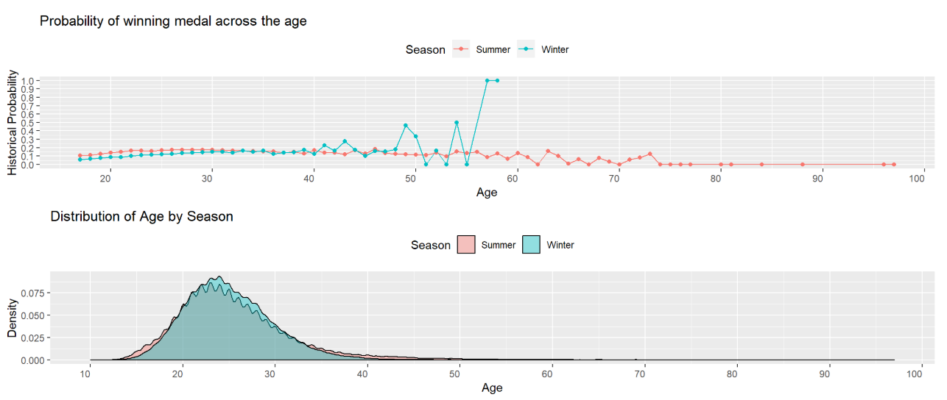
Probability of winning medal By AGE & age distribution by SEASON

Slide 12
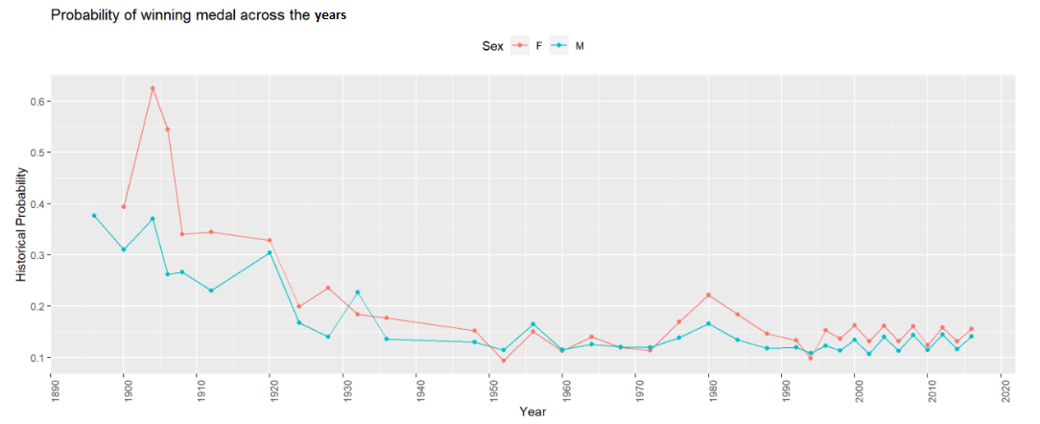
Probability of winning medal over the Years

Slide 13
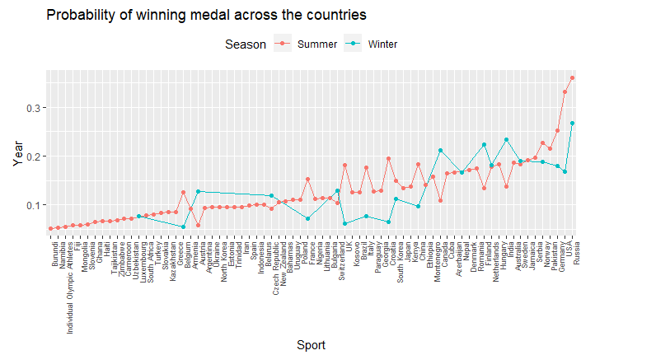
Probability of winning medal across Countries

Slide 14
STATISTICAL METHOD
Random Forest Classifier

Slide 15
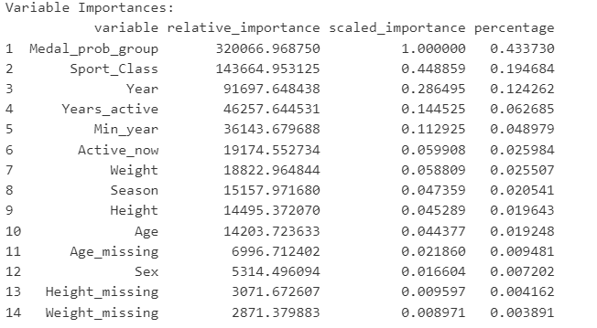
Variable’s Importance

Slide 16
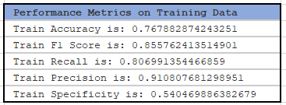
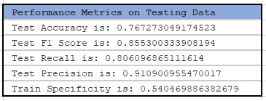
TRAINING & TESTING DATA PERFORMANCE METRICS
Notes:
it is clear that the performance of the model is very similar on both Training and Test Datasets. Hence, it is not overfitted.

Slide 17
CONCLUSION
Based on the Random Forest Model’s performance on Training and Test (Unseen) Data :
The target(medal winning) distribution is highly unbalanced (14:86). So, we focus on Recall and Precision instead of accuracy.
80% of the medal winners are captured. (Recall/True Positive Rate is 80%).
Among the athletes classified as medal winners, 91% do win medals (Precision/Positive Predictive Value is 91%)

Slide 18
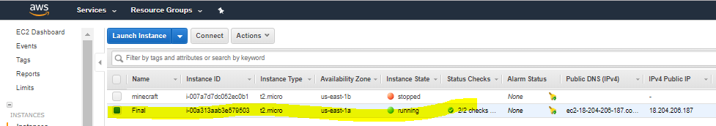
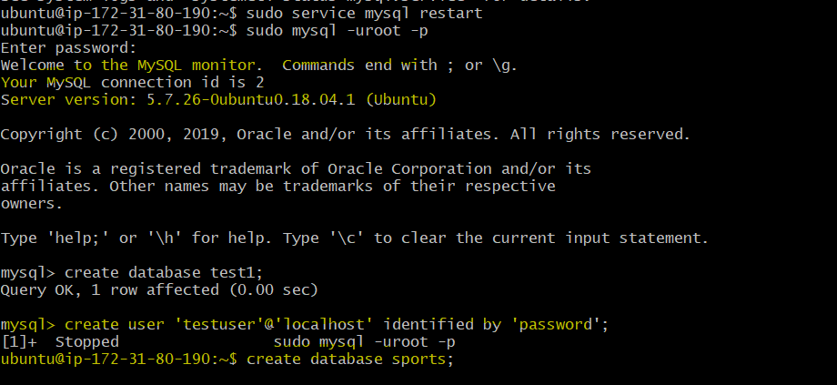
SQL Installation on Ubuntu

Slide 19
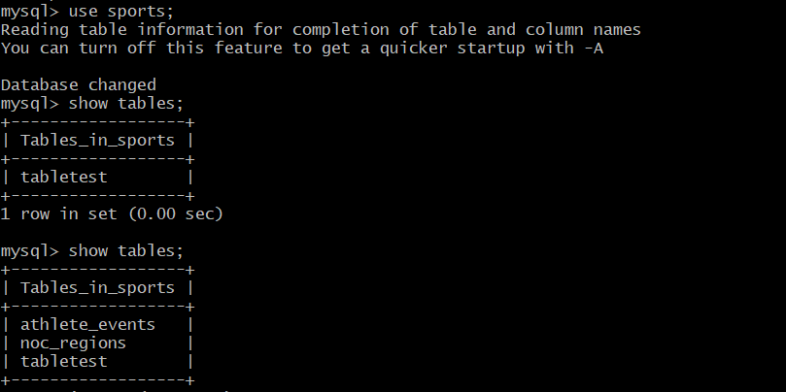
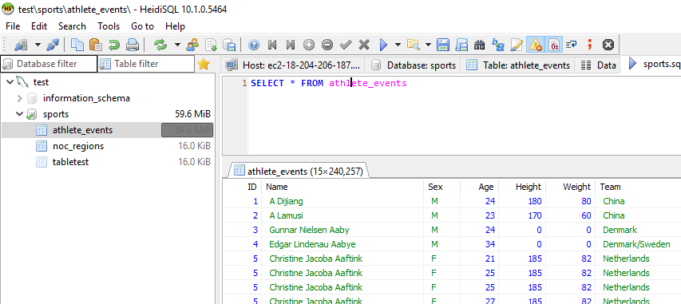
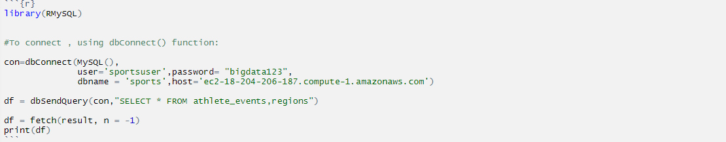
CONNECTION TO SQL & R
SQL (UBUNTU) CONNECTION
SQL CONNECTION
R CONNECTION

Slide 20
THANK YOU

